Slide 2
The mother of Methodism
While writing my book about William Wilberforce, I first came to appreciate the historic and cultural earthquake known as the Wesleyan Revival. Most of the dramatic social advances of the nineteenth century—including all that Wilberforce and his friend Hannah More were able to accomplish—were a direct result of that unprecedented outpouring of faith. It can be said without exaggeration that John and Charles Wesley’s efforts—their evangelism and service to the poor, the disenfranchised, and the hopeless—changed the world. It can also be said without exaggeration that who these great men were and all they did in their lives had everything to do with the extraordinary woman who raised them. (Metaxas 31)

Slide 4
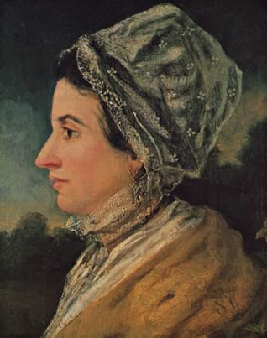
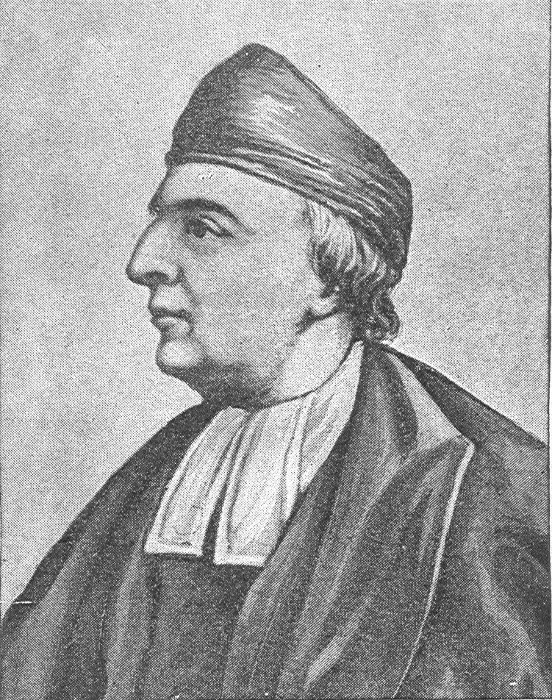
Susanna and Samuel

Slide 6
Church of England and the Wesleys
200, Tertullian
300, Church councils
400, Pelagius
597, Augustine of Canterbury’s mission
1331–1384, John Wycliffe
1531–1534, Henry VIII breaks with Rome
1547–1553, Edward VI
1553–1558, “Bloody” Mary
1558–1603, Elizabeth I
1603–1625, James I
1642–1651, English Civil War and execution of Charles I
1649–1660, Commonwealth and the Cromwells
1660–1685, Charles II, Great Plague
1685–1688, James II
1689–1702, William of Orange
1662–1735, Samuel Wesley
1669–1742, Susanna Annesley Wesley
1703–1791, John Wesley
1828, repeal of Test Act and Corporation Act

Slide 8
Knowing God
[Reflecting on what we can know about God in creation] is to know God, as a man, as a reasonable creature: but this is not that knowledge that leadeth us to eternal life. That is a knowledge of another kind: the one we attain in a scientifical method, by a long train of arguments . . .; the other, by frequent and fervent application to God in prayer. The one is an effect of human reason assisted by human learning, . . . . The other is reason acting by the influence and direction of the Holy Spirit; God known to the heart, the will and its affections, not merely as the author of our being, but as he is exhibited to us under the character of a healer, a repairer of the lapse and misery of human nature, a Saviour, him whom our soul loveth. (Newton 155)

Slide 10
The high call of parenting
[I] consider ‘tis no small honour to be entrusted with the care of so many souls . . . [I]t will be certainly no little accession to the future glory to stand forth at the last day and say, “Lord, here are the children which Thou hast given me, of whom I have lost none by my ill example, nor by neglecting to instill in their minds, in their early years, the principles of Thy true religion and virtue!” (Metaxas 38)

Slide 11
Early years
[To John] Dear Son, According to your desire, I have collected the principal rules I observed in educating my family. The children were always put into a regular method of living, in such things as they were capable of, from their birth; as in dressing and undressing, changing their linen, &c. The first quarter commonly passes in sleep. After that, they were, if possible, laid into their cradle awake, and rocked to sleep; and so they were kept rocking till it was time for them to awake. This was done to bring them to a regular course of sleeping, which at first was three hours in the morning, and three in the afternoon; afterwards two hours, till they needed none at all. When turned a year old (and some before), they were taught to fear the rod, and to cry softly, by which means they escaped abundance of correction which they might otherwise have had; and that most odious noise of the crying of children was rarely heard in the house, but the family usually lived in as much quietness as if there had not been a child among them. (Newton 108)

Slide 12
By–laws
[To John] There were several bye-laws observed among us. I mention them here because I think them useful.
It had been observed that cowardice and fear of punishment often lead children into lying; till they get a custom of it which they cannot leave. To prevent this, a law was made that whoever was charged with a fault, of which they were guilty, if they would ingenuously confess it, and promise to amend, should not be beaten . . .
That no sinful action, as lying, pilfering at Church or on the Lord’s-day, disobedience, quarrelling, &c., should ever pass unpunished.
That no child should ever be chid or beat twice for the same fault; and that, if they amended, they should never be upbraided with it afterwards.
That every signal act of obedience, especially when it crossed upon their own inclinations, should be always commended, and frequently rewarded, according to the merits of the case.
That if ever any child performed an act of obedience, or did any thing with an intention to please, though the performance was not well, yet the obedience and intention should be kindly accepted, and the child with sweetness directed how to do better for the future.

Slide 13
By–laws, continued
That propriety be inviolably preserved; and none suffered to invade the property of another in the smallest matter, though it were but of the value of a farthing, or a pin; which they might not take from the owner without, much less against, his consent. This rule can never be too much inculcated on the minds of children; and from the want of parents or governors doing it as they ought, proceeds that shameful neglect of justice which we may observe in the world.
That promises be strictly observed; and a gift once bestowed, and so the right passed away from the donor, be not resumed, but left to the disposal of him to whom it was given; unless it were conditional, and the condition of the obligation not performed.
That no girl be taught to work till she can read very well; and then that she be kept to her work with the same application, and for the same time, that she was held to in reading. This rule also is much to be observed; for the putting children to learn sewing before they can read perfectly is the very reason why so few women can read fit to be heard, and never to be well understood. (Newton 112-113)

Slide 14
Priorities
[To Samuel] I do not know what time is assigned to you for [recreation], and I think your health and studies require that you should use a pretty deal of exercise. You know whether your heart be too much set upon it. If it be, I will tell you what rule I observed in the same case when I was young and too much addicted to childish diversions, which was this: never to spend more time in any matter of mere recreation in one day than I spent in private religious duties. I leave it to your consideration whether this is practicable by you or not. I think it is. (Newton 55)

Slide 15
Will
[To John] In order to form the minds of children, the first thing to be done is to conquer their will, and bring them to an obedient temper. To inform the understanding is a work of time; and must with children proceed by slow degrees, as they are able to bear it; but the subjecting the will is a thing which must be done at once, and the sooner the better; for by neglecting timely correction, they will contract a stubbornness and obstinacy which are hardly ever after conquered, and never without using such severity as would be as painful to me as to the child. (Newton 113)

Slide 16
Will
In the esteem of the world, they pass for kind and indulgent, whom I call cruel parents; who permit their children to get habits which they know must be afterwards broken. Nay, some are so stupidly fond, as in sport to teach their children to do things, which in a while after they have severely beaten them for doing. When a child is corrected it must be conquered, and this will be no hard matter to do, if it be not grown headstrong by too much indulgence. And when the will of a child is totally subdued, and it is brought to revere and stand in awe of the parents, then a great many childish follies and inadvertences may be passed by. Some should be overlooked and taken no notice of, and others mildly reproved; but no willful transgression ought ever to be forgiven children, without chastisement, less or more, as the nature and circumstances of the offence may require. I insist upon conquering the will of children betimes, because this is the only strong and rational foundation of a religious education, without which both precept and example will be ineffectual. But when this is thoroughly done, then a child is capable of being governed by the reason and piety of its parents, till its own understanding comes to maturity, and the principles of religion have taken root in the mind. (Newton 114)

Slide 17
Will
I cannot yet dismiss this subject. As self-will is the root of all sin and misery, so whatever cherishes this in children insures their after wretchedness and irreligion; whatever checks and mortifies it promotes their future happiness and piety. This is still more evident if we farther consider that religion is nothing else than the doing the will of God, and not our own; that the one grand impediment to our temporal and eternal happiness being this self-will, no indulgences of it can be trivial, no denial unprofitable. Heaven or hell depends on this alone. So that the parent who studies to subdue it in his child, works together with God in the renewing and saving a soul. The parent who indulges it does the devil’s work; makes religion impracticable, salvation unattainable, and does all that in him lies to damn his child soul and body, for ever. (Newton 116)

Slide 19
Reflections
Draw strength from God in prayer
Rest in your salvation and also run that you may obtain the prize
Pursue all the fruits of the Spirit
Earnestly invest in your children’s spiritual growth
Do not despise small beginnings

